Slide 1
zekeLabs
Learning made Simpler ! www.zekeLabs.com

Slide 2
Docker Services

Slide 3
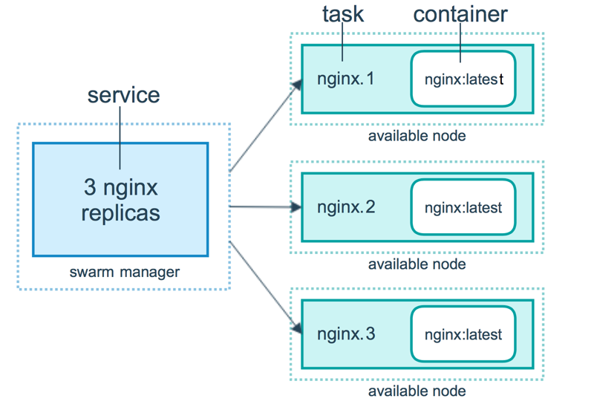
Docker service

Slide 4
Docker service
A service is a group of containers of the same image:tag.
For scaling, load balancing and grouping.
Docker service commands work only on swarm manager not on worker node.

Slide 5
Steps to create a Docker service
Choose a Container Image Images can come from Docker Cloud’s Jumpstarts library, your personal Docker Hub account or Docker Hub’s public index, or from third party registries you connect.
Configure the Service From here, give the service a name, set the initial number of containers, expose/publish ports, modify the run command or entrypoint, set memory and CPU limits.
Set Environment variables Set the edit environment variables and link your service to other existing services.

Slide 6
Docker service Commands
Command | Description
docker service create | Create a new service
docker service inspect | Display detailed information of services
docker service logs | Fetch the logs of a service or task
docker service ls | List services
docker service ps | List the tasks of one or more services
docker service rm | Remove one or more services
docker service rollback | Revert changes to a service’s configuration
docker service scale | Scale one or multiple replicated services
docker service update | Update a service

Slide 7
Docker service Commands
$ docker service create nginx
$ docker service create --name my_web nginx
$ docker service ls
$ docker login registry.example.com
$ docker service create --with-registry-auth --name my_service registry.example.com/acme/my_image:latest
$ docker service update --publish-add 80 my_zekelabs ## Adding a port 80 with the service for outside world
$ docker service create --name zekeCalling --env MYVAR=myvalue --workdir /tmp --user my_user alpine ping docker.com
$ docker service create --name my_web --replicas 3 --publish published=8080, target=80 nginx

Slide 8
Docker Compose

Slide 9
Docker compose
Compose is a tool for defining and running multi-container Docker applications.
With Compose, you use a YAML file to configure your application’s services.
With a single command, create and start all the services from your configuration.

Slide 10
Docker installation
sudo curl -L "https://github.com/docker/compose/releases/download/1.23.1/docker-compose-$(uname -s)-$(uname -m)" -o /usr/local/bin/docker-compose
sudo chmod +x /usr/local/bin/docker-compose

Slide 11
THANK YOU
Let us know how can we help your organization to Upskill the employees to stay updated in the ever-evolving IT Industry.
Get in touch:
www.zekeLabs.com | +91-8095465880 | info@zekeLabs.com
Visit : www.zekeLabs.com for more details

